Slide 1
DormEase
Group Information
Subsection: A2
Group ID: 2
Presented By
Rakib Ahsan
1905024
Al-Amin Sany
1905048
Bijoy Ahemd Saiem
1905052

Slide 2
Introduction
Streamlining and enhancing the management of a hall through innovative software solutions.
It will be a comprehensive platform designed to streamline communication, address concerns, and enhance the overall experience for both students and hall authorities.

Slide 3
Key Modules
Newsfeed
Notice Board
Complaint Box
Seat Allocation Information
Hall Welfare Trust Fund

Slide 4

Newsfeed
Purpose: Foster community engagement and information circulation.
Features:
Authority and student can posts on events, buy/sell, achievements, etc.
Dynamic and interactive platform for real-time updates.
Promotes engagement and information sharing within the hall community.

Slide 5
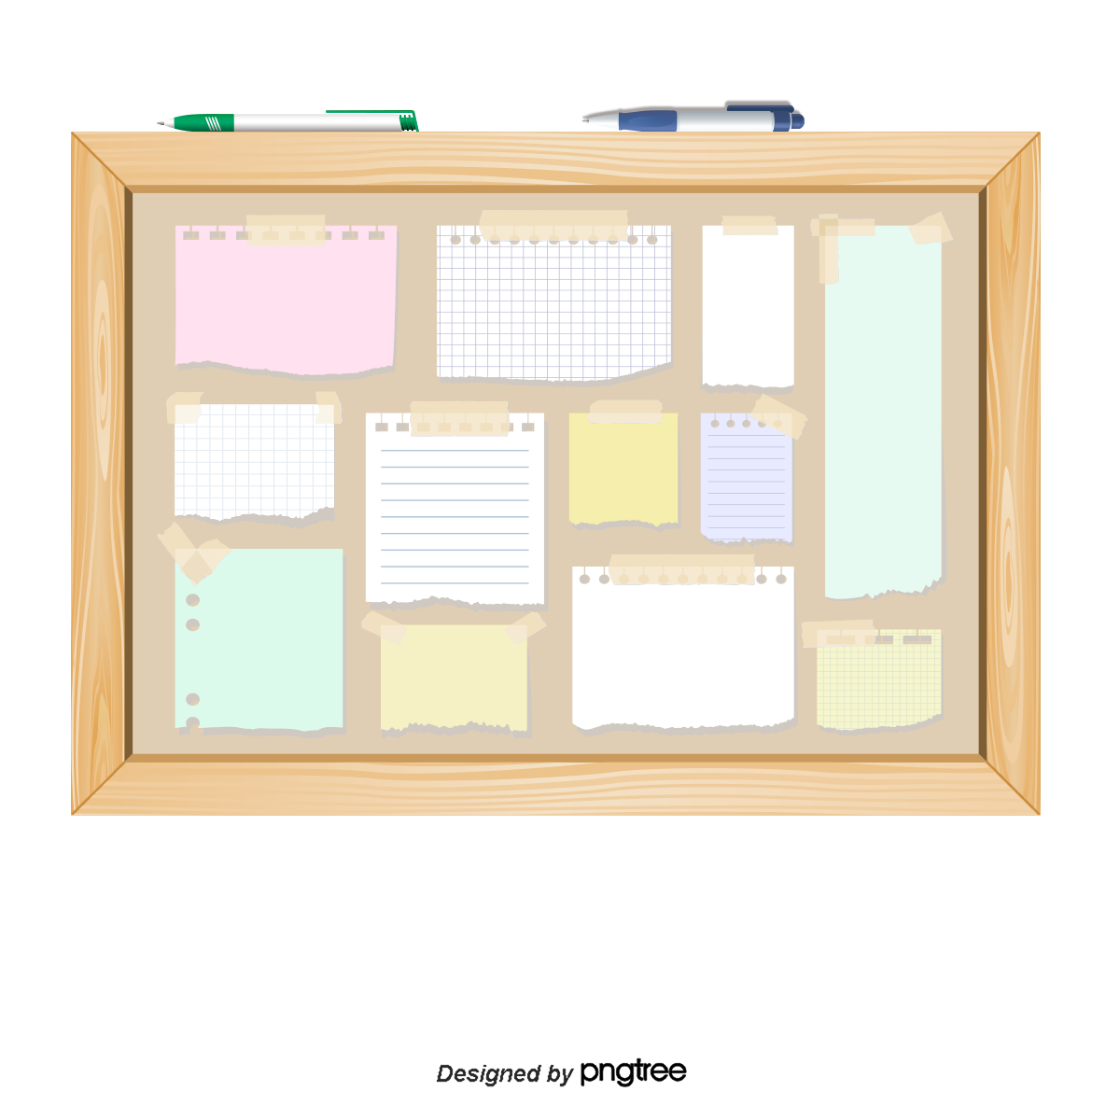
Notice Board
Purpose: Centralized hub for official announcements and student-driven initiatives.
Features:
Important notices from hall authorities.
Student-driven notices for positions like mess manager with an application process.

Slide 6

Complaint Box
Purpose: Empower students to address concerns and contribute to a responsive hall management.
Features:
A platform for students to raise complaints or issues and anonymous complaint submissions.
Trackable complaint resolution process.
Efficient management of reported concerns.

Slide 7
Seat Allocation Information
Purpose: Streamline the seat allocation process for improved efficiency.
Features:
Admin tools for managing seat allocations and allows admins to facilitate the seat allocation process.
Ensures fair and organized seat allocation for students.
Student-facing interface to view and confirm seat allocations.

Slide 8

Hall Welfare Trust Fund
Purpose: Facilitate financial assistance requests and approvals.
Features:
Seamless request submission for monetary aid which enables students or alumni to request monetary aid from the hall fund.
Transparent and streamlined approval or rejection process.

Slide 9
Problems we are solving
Improved Communication:
Enhance communication between students and authorities.
Real-time updates on events, announcements, and community activities.
Efficient Complaint Resolution:
Empower students to voice concerns.
Trackable resolution process for quick and effective solutions.
Streamlined Administrative Processes:
Simplify seat allocation procedures.
Centralized hub for official notices and student-driven initiatives.
Transparent Financial Assistance:
Provide a structured process for students to seek financial help.
Ensure transparency in fund request approvals or rejections.

Slide 10
Thank You

